Slide 1



Tech Store Platform

Slide 2

Content
1.Team Profile 2.Project Overview 3.Benefit of TechStore 4.Project Feature 5.Project Demo 6.Conclusion 7.Question and Answer

Slide 3



Team Profile
KOL Sokvebol
PHOR Sith
SOEUN Sreykhuoch

Slide 4

Project Overview
Tech Store is the platform that provide the customer place to order the product by online or the customer seller the product.
It is the online shopping of electronic commerce which allows the consumers to directly buy goods or service from the seller by web browser or mobile app.

Slide 5

Benefit of Tech Store
The clients easy and safe to by the product from online
The clients can buy whatever they want to buy in the world.
They will save time and easy to do research the products by online.
Most of the tech stores online have competitive prices (discorded and promotion)

Slide 6
Project Features
Login page
Homepage-header and banner
Homepage-new promotion
Homepage-section advertisement and footer
List of product best seller
Shop by category
Contact us page

Slide 7
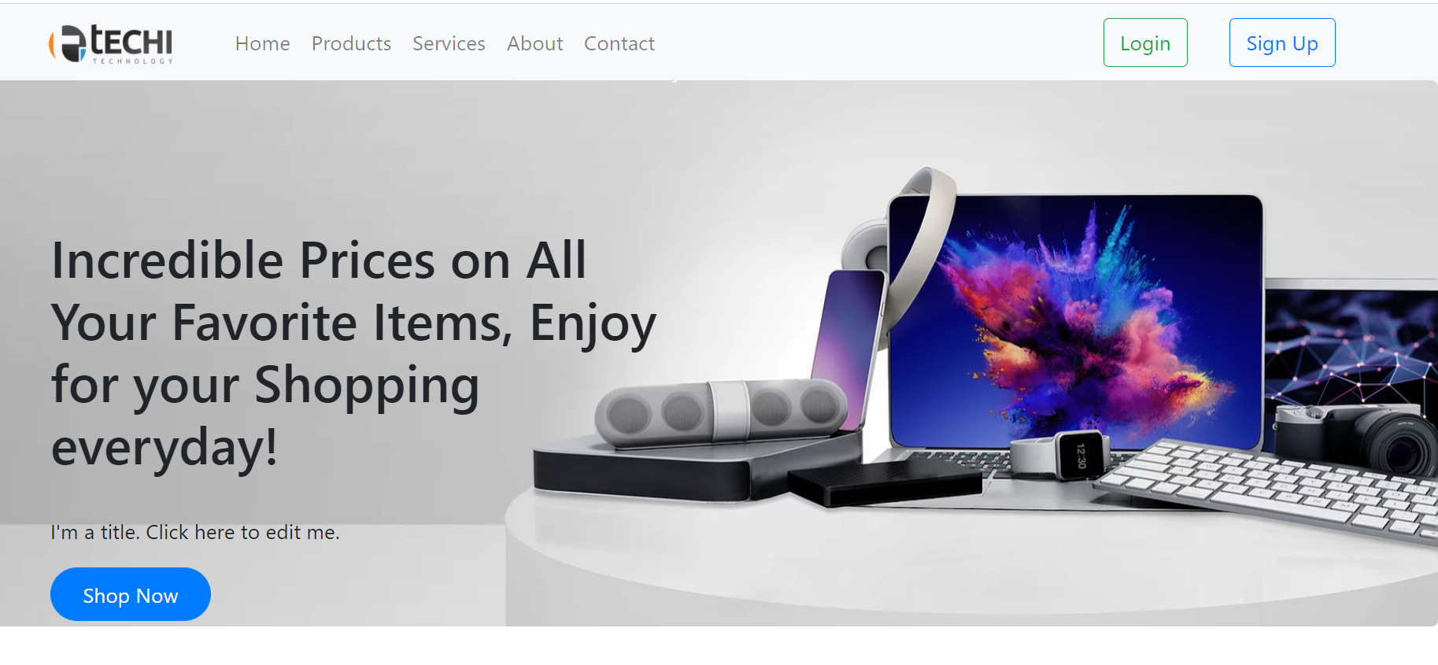
Demo Project
- Demo TechStore

Slide 8

Conclusion
What is TechStore?
The benefit of the TechStore platform.
The Feature of the TechStore

Slide 9

Question & Answer
Do you have any question?

